Slide 1
Big Data & Graphs

Slide 2
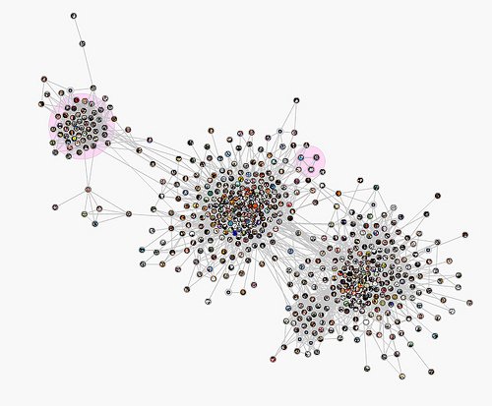
Graphs organize data in a way that emphasizes the relationship (edges) between entities (nodes).
Nodes are connected through edges. Patterns emerge by seeing e.g. how densely connected groups of nodes are.

Slide 3
Graphs on Big Data
Graph is a great paradigm for modeling any sort of network or relationship data:
Social networks
Computer networks
Customers purchasing/downloading items
People visiting locations
Companies paying other companies
It’s easy to see how these data sets on a large scale can amount to a Big Data problem

Slide 4
Graph Data
Data often doesn’t come naturally as a graph. Graphs are a data organization paradigm which facilitates querying the data in ways that cares about relationships.
Some sort of transformation process has to move the data into a graph format of nodes and edges.
Big Data platforms and/or streaming technologies can convert data at scale, if necessary.

Slide 5
Analyzing Graphs
You can take a graph mentality by writing basic Spark or Python code. However, several graph databases and frameworks exist for making working with graphs easier and more efficient.
At scale, though, most technologies fall into two camps and no technology can do both:
Retrieving individual pieces of data (i.e., fetching) from a large data set quickly
Analyzing and summarizing the data set as a whole (i.e., batch)
It’s important to realize which type of technology you are using and what it’s good at.
For example, Titan uses an HBase back end to handle the fetch use case, and uses Spark to handle the batch use case.

Slide 6
Graph Algorithms: PageRank
PageRank was an algorithm originally developed by Google to rank the importance of websites. It uses the assumption that more important pages are linked to, specifically if an important page links to it.
PageRank is a graph-wide operation and will operate in batch. The way it works is it calculates the probability distribution that you will land on a particular site if you just randomly click links on pages.
Can be used to find important nodes in any network, not just websites.
For example, it can be used to find important people in social networks or important devices in a computer network.

Slide 7
Graph Algorithms: Connected Components
A connected component of an undirected graph is a maximal set of nodes such that each pair of nodes is connected by a path.
Finding connected components can be computationally expensive on very large graphs.
Can be used to find large subsections of the data set, that perhaps can get segmented

Slide 8
Graph Algorithms: Shortest path traversal
In graph theory, the shortest path problem is the problem of finding a path between two vertices (or nodes) in a graph such that the sum of the weights of its constituent edges is minimized.
This is typically done with Breadth First Search and can be computationally expensive if the potential path is very far. In practice, only good for 3-4 hops out in most data sets.
Could be useful for determining how one node is related to another node or which shared connections two nodes have.

Slide 9
Graph Algorithms: Recommendation Engines
Graphs can be the foundation for a number of different types of recommendation engines.
To recommend connections that should be there (such as recommending friends in a social network) you can use missing edge prediction, or just simply find who has the most shared connections.
Users buying items can be modeled as a bipartite graph between customers and items. Collaborative filtering recommendations for a user can be calculated quickly by looking at that user’s purchases, then using the graph to find the users who purchased that same item, and then the items they purchased.

Slide 10
Graph Technologies

Slide 11
Graph Technologies
In this section, we’ll go over a survey of different graph-specific technologies
Titan
GraphX
GraphFrames
Neo4j

Slide 12
Titan - Introduction
Titan is designed to support the processing of graphs so large that they require storage and computational capacities beyond what a single machine can provide. Scaling graph data processing for real time traversals and analytical queries is Titan’s foundational benefit.
Support for very large graphs. Titan graphs scale with the number of machines in the cluster.
Support for many concurrent transactions and operational graph processing.
Support for global graph analytics and batch graph processing through the Hadoop framework.
Support for geo, numeric range, and full text search for vertices and edges on very large graphs.
Numerous graph-level configurations provide knobs for tuning performance.
Vertex-centric indices provide vertex-level querying to alleviate issues with the infamous super node problem.
Provides an optimized disk representation to allow for efficient use of storage and speed of access.
Open source under the liberal Apache 2 license.
Notes:
http://s3.thinkaurelius.com/docs/titan/1.0.0/benefits.html

Slide 13
Titan - Related Technologies
Support for ACID and eventual consistency.
Support for various storage backends:
Apache Cassandra
Apache HBase
Oracle BerkeleyDB
Support for global graph data analytics, reporting, and ETL through integration with big data platforms:
Apache Spark
Apache Giraph
Apache Hadoop
Support for geo, numeric range, and full-text search via:
ElasticSearch
Solr
Lucene
Native integration with the TinkerPop graph stack:
Gremlin graph query language
Gremlin graph server
Gremlin applications
Notes:
http://titan.thinkaurelius.com/

Slide 14
Titan - Nature of Code
Gremlin is Titan’s query language used to retrieve data from and modify data in the graph. Gremlin is a path-oriented language which succinctly expresses complex graph traversals and mutation operations. Gremlin is a functional language whereby traversal operators are chained together to form path-like expressions.
The Gremlin terminal is a Groovy shell. Groovy is a superset of Java that has various shorthand notations that make interactive programming easier. Likewise Gremlin is a superset of Groovy with various shorthand notations that make graph traversals easy.
Titan requires Java 8 (Standard Edition). Oracle Java 8 is recommended.
Notes:
http://s3.thinkaurelius.com/docs/titan/1.0.0/getting-started.html

Slide 15
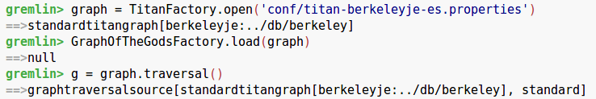
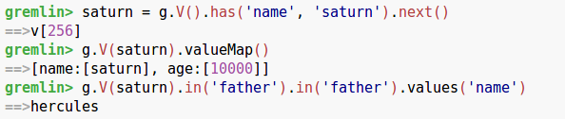
Titan - Example Code
Loading the Graph of the Gods Into Titan
Using a Graph Index and Traversals

Slide 16
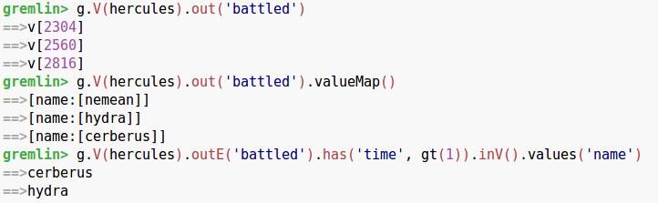
Titan - Example Code
Graph Traversal
http://gremlindocs.spmallette.documentup.com/

Slide 17
Titan - from a file
Can write groovy script and pass into Gremlin shell as an interpreter
For example, the file test.groovy
g = HadoopFactory.open('conf/hadoop/titan-graphson.properties') g.V.out('father').name.submit()
Can be executed through the gremlin shell:
bin/gremlin.sh -e test.groovy

Slide 18
Current state of Titan project
Titan as of recently has been forked in two directions:
Datastax (Cassandra vendor) Enterprise Graph, a proprietary version that is being built by the original developers
JanusGraph, an open source fork of Titan that looks for the most part to be the same.

Slide 19
GraphX - Introduction
GraphX is a component in Spark for graphs and graph-parallel computation. At a high level, GraphX extends the Spark RDD by introducing a new Graph abstraction: a directed multigraph with properties attached to each vertex and edge
GraphX is Apache Spark's API for graphs and graph-parallel computation (using RDDs).
Seamlessly work with both graphs and collections.
Comparable performance to the fastest specialized graph processing systems.
Choose from a growing library of graph algorithms.
GraphX is developed as part of the Apache Spark project. It thus gets tested and updated with each Spark release.
GraphX is available for Scala.
Notes:
https://spark.apache.org/graphx/

Slide 20
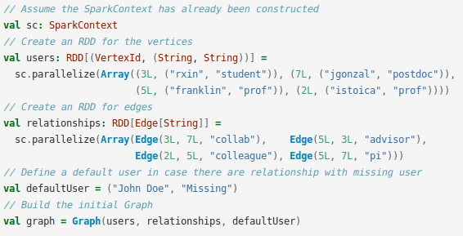
GraphX - Example Code
Construct a graph from a collection of RDDs:

Slide 21
GraphFrames - Introduction
GraphFrames is a package for Apache Spark which provides DataFrame-based Graphs.
GraphFrames are to DataFrames as GraphX is to RDDs.
GraphFrames is a package for Apache Spark which provides DataFrame-based Graphs. The current plan is to keep GraphFrames separate from core Apache Spark for the time being.
Get GraphFrames from the Spark Packages website. GraphFrames should be compatible with any platform which runs Spark.
High-level APIs in Scala, Java, and Python.
GraphFrames is tested with Java 7, Python 2 and 3, and running against Spark 1.6+ (Scala 2.10) and Spark 2.0+ (Scala 2.11).
Notes:
https://graphframes.github.io/

Slide 22
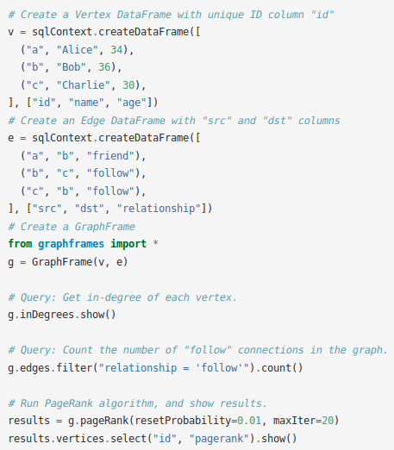
GraphFrames - Example Code
How to create a GraphFrame, query it, and run the PageRank algorithm.
Notes:
https://graphframes.github.io/quick-start.html
https://graphframes.github.io/user-guide.html

Slide 23
Neo4j - Introduction
Neo4j’s Graph Platform is built around the Neo4j native graph database.
It is an open source software that stores and queries data as nodes and relationships using the Cypher query language with index free adjacency.
The Neo4j native graph database supports transactional applications and graph analytics
Graph analytics help data scientists gain new perspectives on data
Data integration expedites distilling tabular data and big data into graphs
The Cypher graph query language is the bridge to big data analytic tooling
Graph visualization and discovery help communicate graph technology benefits throughout the organization
Enterprise architecture underlies and supports massive graph data

Slide 24
Neo4j - Related Technologies
The Graph Platform fits seamlessly into enterprise data architectures, alongside, around and above relational warehouses, data lakes, cloud and legacy systems. Many customers have deployed Neo4j to augment their existing infrastructures without interrupting everyday operations.
Cypher query language can be used on Apache Spark.

Slide 25
Neo4j - Nature of Code
Neo4j is implemented in Java and accessible from software written in other languages using the Cypher Query Language through a transactional HTTP endpoint, or through the binary "bolt" protocol. JavaScript driver can connect to create web applications.
Notes:
https://en.wikipedia.org/wiki/Neo4j

Slide 26
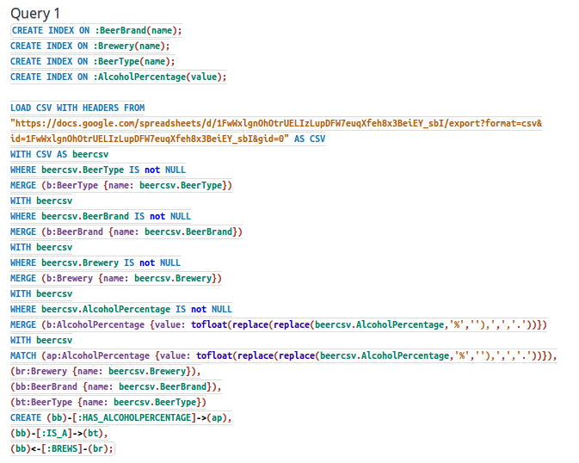
Neo4j - Example Code
Data loading query

Slide 27
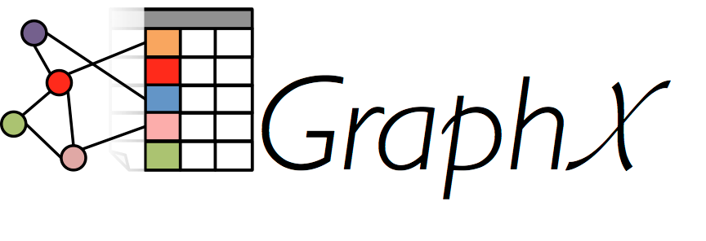
GraphX
New Spark API for graphs (e.g., Web-Graphs and Social Networks) and graph-parallel computation (e.g., PageRank and Collaborative Filtering)
Notes:
GraphX is a new component in Spark for graphs and graph-parallel computation
At a high level, GraphX extends the Spark RDD by introducing a new Graph abstraction: a directed multigraph with properties attached to each vertex and edge
GraphX exposes a set of fundamental operators
subgraph
joinVertices
aggregateMessages

Slide 28
Why GraphX?
Growing scale and importance of graph data has driven the development of numerous new graph-parallel systems
Same restrictions that enable these graph-parallel systems to achieve substantial performance gains also limit their ability to express many of the important stages in a typical graph-analytics pipeline
They are also not well suited to more basic tasks like constructing the graph, modifying its structure, or expressing computation that spans multiple graphs
These tasks typically require data-movement outside of the graph topology and are often more naturally expressed as operations on tables in more traditional data-parallel systems like Map-Reduce
Notes:
Giraph originated as the open-source counterpart to Pregel and used at Facebook to analyze the social graph

Slide 29
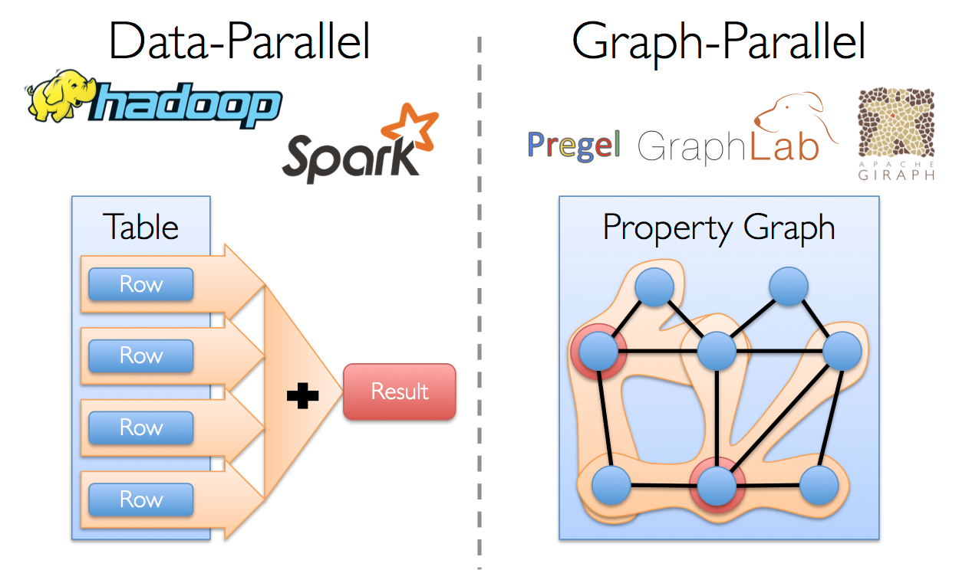
Why GraphX?
The goal of the GraphX project is to unify graph-parallel and data-parallel computation in one system with a single composable API.
GraphX API enables users to view data both as graphs and as collections (i.e., RDDs) without data movement or duplication.
Notes:
The GraphX API enables users to view data both as graphs and as collections (i.e., RDDs) without data movement or duplication

Slide 30
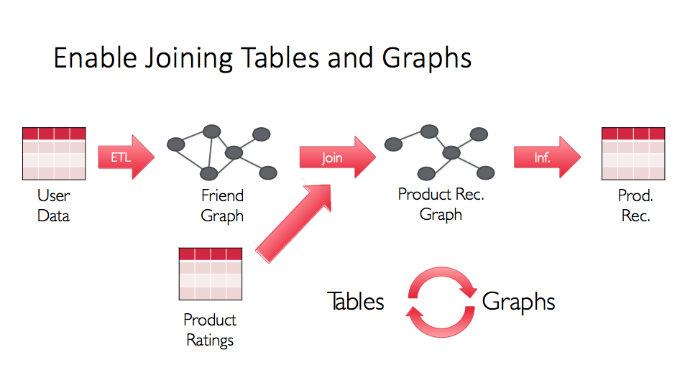

Slide 31
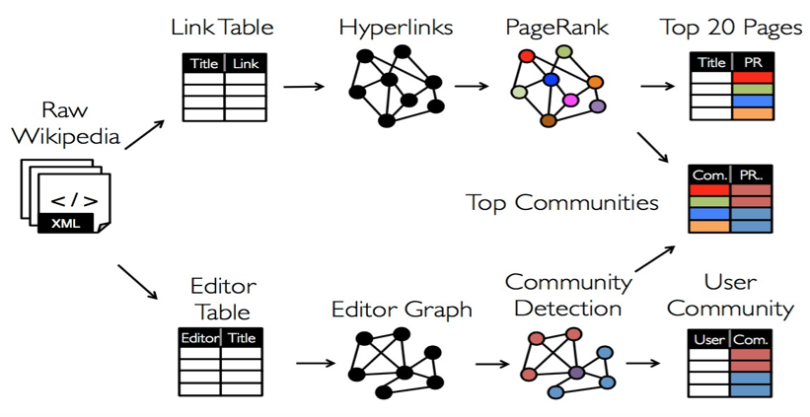
Table and Graph Analytics

Slide 32
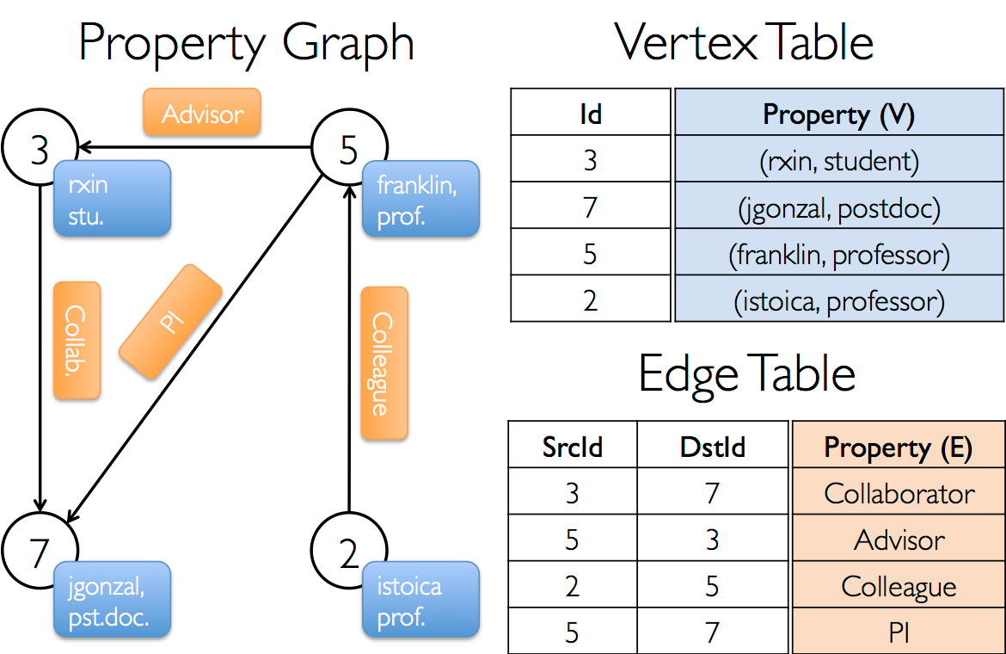
GraphX API
Extends the Spark RDD abstraction by introducing the
Resilient Distributed Property Graph:
Directed multigraph with properties attached to each vertex and edge
Each vertex is keyed by a unique 64-bit long identifier (VertexID)
Edges have corresponding source and destination vertex identifiers
Properties are stored as Scala objects with each edge and vertex in the graph
Notes:
Extends the Spark RDD abstraction by introducing the Resilient Distributed Property Graph:
Property Graph is a directed multigraph Directed multigraph with properties attached to each vertex and edge
Multigraph
a directed graph with potentially multiple parallel edges sharing the same source and destination vertex)
with properties attached to each vertex and edge
Suppose we want to construct a property graph consisting of the various collaborators on the GraphX project
The vertex property might contain the username and occupation
We could annotate edges with a string describing the relationships between collaborators

Slide 33
GraphX API
GraphX exposes a set of fundamental operators
e.g., subgraph, joinVertices, and mapReduceTriplets
and an optimized variant of the Pregel API
graph-parallel abstractions to express iterative algorithms that re-compute the properties of each vertex until a fixed-point condition is reached (common approach in graph algorithms)
Includes growing collection of graph algorithms and builders to simplify graph analytics tasks.
GraphX API is currently only available in Scala but Java and Python bindings anticipated in the future

Slide 34
Property Graph
A property graph is parameterized over the vertex (VD) and edge (ED) types
These are the types of the objects associated with each vertex and edge respectively.
class Graph[VD, ED] { val vertices: VertexRDD[VD] val edges: EdgeRDD[ED] }
VertexRDD[VD] = RDD[(VertexID, VD)] EdgeRDD[ED] = RDD[Edge[ED]]
Notes:
The classes VertexRDD[VD] and EdgeRDD[ED] extend and are optimized versions of RDD[(VertexID, VD)]and RDD[Edge[ED]] respectively
Both VertexRDD[VD] and EdgeRDD[ED] provide additional functionality built around graph computation and leverage internal optimizations

Slide 35
Example Graph Construction
The most general way to construct a graph is using the Graph object
// Assume the SparkContext has already been constructed val sc: SparkContext // Create an RDD for the vertices val users: RDD[(VertexId, (String, String))] = sc.parallelize(Array((3L, ("rxin", "student")), (7L, ("jgonzal", "postdoc")), (5L, ("franklin", "prof")), (2L, ("istoica", "prof")))) // Create an RDD for edges val relationships: RDD[Edge[String]] = sc.parallelize(Array(Edge(3L, 7L, "collab"), Edge(5L, 3L, "advisor"), Edge(2L, 5L, "colleague"), Edge(5L, 7L, "pi"))) // Define a default user in case there are relationship with missing user val defaultUser = ("John Doe", "Missing") // Build the initial Graph val graph = Graph(users, relationships, defaultUser)
Notes:
Steps
Create an RDD for the vertices
Vertex properties are tuples of (username, position)
Create an RDD for the edges
Edge properties are the relationships between collaborators
Define a default user
Build the graph
In this example we make use of the Edge case class
Edges have a srcId and a dstId corresponding to the source and destination vertex identifiers.
In addition, the Edge class has an attr member which stores the edge property

Slide 36
Graph Views
We can deconstruct a graph into the respective vertex and edge views by using the graph.vertices and graph.edges members respectively.
val graph: // Constructed from above // Count all users which are postdocs graph.vertices.filter { case (id, (name, pos)) => pos == "postdoc" }.count // Count all the edges where srcID > dstID graph.edges.filter(e => e.srcId > e.dstId).count

Slide 37
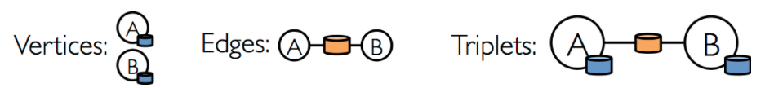
Triplet View
In addition to the vertex and edge views of the property graph, GraphX also exposes a triplet view.
The triplet view logically joins the vertex and edge properties yielding an RDD[EdgeTriplet[VD, ED]] containing instances of the EdgeTriplet class.

Slide 38
Triplet View
The EdgeTriplet class extends the Edge class by adding the srcAttr and dstAttr members which contain the source and destination properties respectively.
We can use the triplet view of a graph to render a collection of strings describing relationships between users.
val graph: Graph[(String, String), String] // Constructed from above // Use the triplets view to create an RDD of facts. val facts: RDD[String] = graph.triplets.map(triplet => triplet.srcAttr._1 + " is the " + triplet.attr + " of " + triplet.dstAttr._1) facts.collect.foreach(println(_))

Slide 39
Resilient Distributed Graphs
Like RDDs, property graphs are immutable, distributed, and fault-tolerant.
Changes to the values or structure of the graph are accomplished by producing a new graph with the desired changes
As with RDDs, each partition of the graph can be recreated on a different machine in the event of a failure
Notes:
Like RDDs, property graphs are immutable, distributed, and fault-tolerant.
Changes to the values or structure of the graph are accomplished by producing a new graph with the desired changes
Note that substantial parts of the original graph (i.e., unaffected structure, attributes, and indicies) are reused in the new graph reducing the cost of this inherently functional data structure
The graph is partitioned across the executors using a range of vertex partitioning heuristics
As with RDDs, each partition of the graph can be recreated on a different machine in the event of a failure.

Slide 40
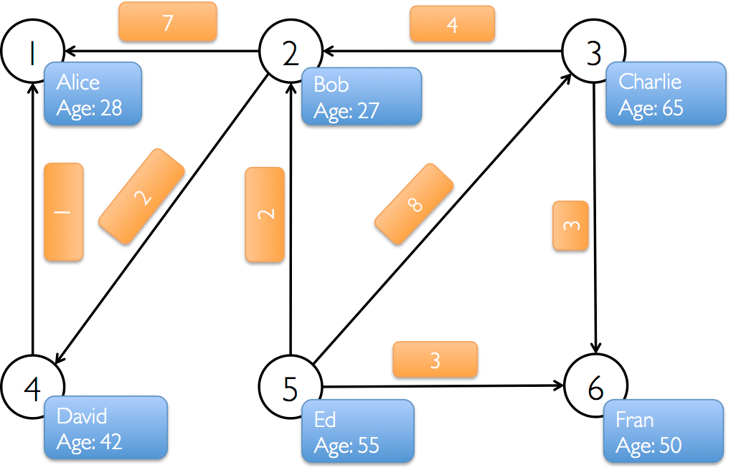
Property Graphs - New example we will work with
import org.apache.spark.graphx._ import org.apache.spark.rdd.RDD val vertexArray = Array( (1L, ("Alice", 28)), (2L, ("Bob", 27)), (3L, ("Charlie", 65)), (4L, ("David", 42)), (5L, ("Ed", 55)), (6L, ("Fran", 50)) ) val edgeArray = Array( Edge(2L, 1L, 7), Edge(2L, 4L, 2), Edge(3L, 2L, 4), Edge(3L, 6L, 3), Edge(4L, 1L, 1), Edge(5L, 2L, 2), Edge(5L, 3L, 8), Edge(5L, 6L, 3) )
Notes:
run this, perhaps ask them to do this first - from here on out, all the code is in graphx_walkthrough.scala
Initialize the vertex and edge array
Vertex
vertex ID
Property of tuple (name, age)
edge
Source ID
Dest ID
Property

Slide 41
Property Graphs
Again, need an RDD of vertices (with type RDD[(VertexId, V)]) and an RDD of edges (with type RDD[Edge[E]]) to build a graph (with type Graph[V, E])
val vertexRDD: RDD[(Long, (String, Int))] = sc.parallelize(vertexArray) val edgeRDD: RDD[Edge[Int]] = sc.parallelize(edgeArray)
val graph: Graph[(String, Int), Int] = Graph(vertexRDD, edgeRDD)
Notes:
run this, perhaps ask them to do this first
Create the Edge and Vertex RDD
We must specify the type because scala can’t infer it
Create the initial graph using the Graph object

Slide 42
Graph Views
Use graph.vertices to display the names of the users that are at least 30 years old:
graph.vertices.filter { case (id, (name, age)) => age > 30 }.collect().foreach { case (id, (name, age)) => println(s"$name is $age") }
or another way:
for ((id,(name,age)) <- graph.vertices.filter { case (id,(name,age)) => age > 30 }.collect) { println(s"$name is $age") }
Notes:
Run this
Note that graph.vertices returns an VertexRDD[(String, String)] which extends RDD[(VertexID, (String, String))] and so we use the scala case expression to deconstruct the tuple.
On the other hand, graph.edges returns an EdgeRDD containing Edge[String] objects.
We could have also used the case class type constructor as in the following:
Case is used for pattern matching

Slide 43
Graph Operators
Just as RDDs have basic operations like count, map, filter, and reduceByKey, property graphs also have a collection of basic operations
e.g.: functions to transform vertex and edge attributes
class Graph[VD, ED] { def mapVertices[VD2](map: (VertexId, VD) => VD2): Graph[VD2, ED] def mapEdges[ED2](map: Edge[ED] => ED2): Graph[VD, ED2] }
Each of these operators yields a new graph with the vertex or edge properties modified by the user defined map function
These operators are often used to initialize the graph for a particular computation or project away unnecessary properties.
Notes:
run this

Slide 44
Graph Operators
Note that in each case the graph structure is unaffected.
This is a key feature of these operators which allows the resulting graph to reuse the structural indices of the original graph.
The following snippets are logically equivalent, but the first one does not preserve the structural indices and would not benefit from the GraphX system optimizations:
val newVertices = graph.vertices.map { case (id, attr) => (id, mapUdf(id, attr)) } val newGraph = Graph(newVertices, graph.edges) OR
val newGraph = graph.mapVertices((id, attr) => mapUdf(id, attr))
Notes:
run this

Slide 45
Graph Operators
There are many functions exposed by the Graph API (take a look)
https://spark.apache.org/docs/latest/api/scala/index.html#org.apache.spark.graphx.GraphOps
Thanks to the “magic” of Scala implicits the operators are automatically available as members of Graph
For example, we can compute the in-degree of each vertex (defined in GraphOps) by the following:
val inDegrees: VertexRDD[Int] = graph.inDegrees
Notes:
run this
graph.inDegrees.collect()
graph.outDegrees.collect()
graph.degrees.collect()

Slide 46
Graph Operators
We compute the max in, out, and total degrees by defining our own reduce operation:
// Define a reduce operation to compute the highest degree vertex def max(a: (VertexId, Int), b: (VertexId, Int)): (VertexId, Int) = { if (a._2 > b._2) a else b } // Compute the max degrees val maxInDegree: (VertexId, Int) = graph.inDegrees.reduce(max) val maxOutDegree: (VertexId, Int) = graph.outDegrees.reduce(max) val maxDegrees: (VertexId, Int) = graph.degrees.reduce(max)
Notes:
Run this

Slide 47
Graph Operators
What if we wanted to incorporate the in and out degree of each vertex into the vertex property?
First we define a User class to better organize the vertex property and build a new graph with the user property
// Define a class to more clearly model the user property case class User(name: String, age: Int, inDeg: Int, outDeg: Int)
// Create a user Graph val initialUserGraph: Graph[User, Int] = graph.mapVertices{ case (id, (name, age)) => User(name, age, 0, 0) }
Notice that we initialized each vertex with 0 in and out degree
Notes:
run this

Slide 48
Graph Operators
Now we join the in and out degree information with each vertex building the new vertex property
Note not all vertices have incoming and outgoing edges (hence outer join)
val userGraph = initialUserGraph.outerJoinVertices(initialUserGraph.inDegrees) { case (id, u, inDegOpt) => User(u.name, u.age, inDegOpt.getOrElse(0), u.outDeg) }.outerJoinVertices(initialUserGraph.outDegrees) {
case (id, u, outDegOpt) => User(u.name, u.age, u.inDeg, outDegOpt.getOrElse(0))
}
The two joins for in and out degree are simply chained together
More explanation on next slide...
Notes:
run this

Slide 49
Graph Operators
val userGraph = initialUserGraph.outerJoinVertices(initialUserGraph.inDegrees) { case (id, u, inDegOpt) => User(u.name, u.age, inDegOpt.getOrElse(0), u.outDeg) }.outerJoinVertices(initialUserGraph.outDegrees) {
case (id, u, outDegOpt) => User(u.name, u.age, u.inDeg, outDegOpt.getOrElse(0))
}
outerJoinVertices has the following (confusing) type signature: def outerJoinVertices[U, VD2](other: RDD[(VertexID, U)]) (mapFunc: (VertexID, VD, Option[U]) => VD2) : Graph[VD2, ED] takes two argument lists:
an RDD of vertex values
a function from the id, attribute, and Optional matching value in the RDD to a new vertex value
If input RDD does not contain values for some of the vertices in the graph, the Option argument is empty and optOutDeg.getOrElse(0) returns 0
Notes:
run this

Slide 50
Graph Operators
Using our new graph, print the number of people who like each user:
for ((id, property) <- userGraph.vertices.collect) {
println(s"User $id is called ${property.name} and is liked by ${property.inDeg} people.")
}
Print the names of the users who are liked by the same number of people they like:
userGraph.vertices.filter {
case (id, u) => u.inDeg == u.outDeg
}.collect.foreach {
case (id, property) => println(property.name)
}
Notes:
run this

Slide 51
Subgraph
Suppose we want to study the community structure of users that are 30 or older
To support this type of analysis GraphX includes the subgraph operator
takes vertex and edge predicates and returns the graph containing only the vertices that satisfy the vertex predicate (evaluate to true) and edges that satisfy the edge predicate and connect vertices that satisfy the vertex predicate
To restrict our graph to the users that are 30 or older:
val olderGraph = userGraph.subgraph(vpred = (id, user) => user.age >= 30)
Notes:
run this

Slide 52
Subgraph
Examine communities in our restricted subgraph:
// compute the connected components
val cc = olderGraph.connectedComponents
// display the component id of each user:
olderGraph.vertices.leftJoin(cc.vertices) {
case (id, user, comp) => s"${user.name} is in component ${comp.get}"
}.collect.foreach{ case (id, str) => println(str) }
Connected components are labeled (numbered) by the lowest vertex Id in that component.
Notes:
run this

Slide 53
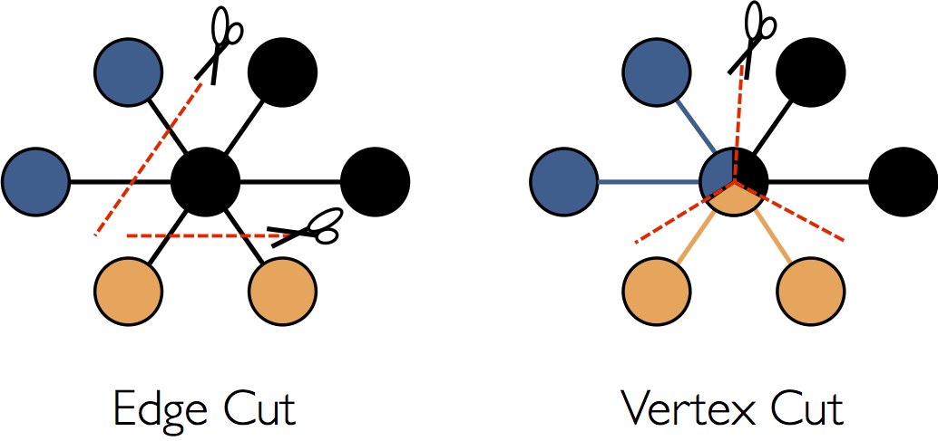
Partitioning
GraphX adopts a vertex-cut approach to distributed graph partitioning
Rather than splitting graphs along edges, GraphX partitions the graph along vertices which can reduce both the communication and storage overhead.

Slide 54
Graph Algorithms
We’ll be looking at some graph algorithms that come with Graphx using the following files as toy examples:
users.txt
1,BarackObama,Barack Obama
2,ladygaga,Goddess of Love
3,jeresig,John Resig
4,justinbieber,Justin Bieber
6,matei_zaharia,Matei Zaharia
7,odersky,Martin Odersky
8,anonsys
followers.txt
2 1
4 1
1 2
6 3
7 3
7 6
6 7
3 7

Slide 55
Page Rank
import org.apache.spark.graphx.GraphLoader // Load the edges as a graph val graph = GraphLoader.edgeListFile(sc, "data/graphx/followers.txt") // Run PageRank val ranks = graph.pageRank(0.0001).vertices // Join the ranks with the usernames val users = sc.textFile("data/graphx/users.txt").map { line => val fields = line.split(",") (fields(0).toLong, fields(1)) } val ranksByUsername = users.join(ranks).map { case (id, (username, rank)) => (username, rank) } // Print the result println(ranksByUsername.collect().mkString("\n"))

Slide 56
Connected Components
import org.apache.spark.graphx.GraphLoader // Load the graph as in the PageRank example val graph = GraphLoader.edgeListFile(sc, "data/graphx/followers.txt") // Find the connected components val cc = graph.connectedComponents().vertices // Join the connected components with the usernames val users = sc.textFile("data/graphx/users.txt").map { line => val fields = line.split(",") (fields(0).toLong, fields(1)) } val ccByUsername = users.join(cc).map { case (id, (username, cc)) => (username, cc) } // Print the result println(ccByUsername.collect().mkString("\n"))

Slide 57
Triangle Counting
import org.apache.spark.graphx.{GraphLoader, PartitionStrategy} // Load the edges in canonical order and partition the graph for triangle count val graph = GraphLoader.edgeListFile(sc, "data/graphx/followers.txt", true) .partitionBy(PartitionStrategy.RandomVertexCut) // Find the triangle count for each vertex val triCounts = graph.triangleCount().vertices // Join the triangle counts with the usernames val users = sc.textFile("data/graphx/users.txt").map { line => val fields = line.split(",") (fields(0).toLong, fields(1)) } val triCountByUsername = users.join(triCounts).map { case (id, (username, tc)) => (username, tc) } // Print the result println(triCountByUsername.collect().mkString("\n"))

Slide 58
Shortest Path
The ShortestPaths GraphX algorithm returns a graph where the vertices RDD contains tuples in the format (vertexId, Map(target -> shortestPath).
This graph will contain all vertices of the original graph, and their shortest paths to all target vertices passed in the Seq argument of the algorithm.
Assuming you have a GraphX graph in g and you want to find the shortest path between the vertices with ids v1 and v2, you can do the following:
import org.apache.spark.graphx.lib.ShortestPaths val result = ShortestPaths.run(g, Seq(v2)) val shortestPath = result // result is a graph .vertices // we get the vertices RDD .filter({case(vId, _) => vId == v1}) // we filter to get only the shortest path from v1 .first // there's only one value ._2 // the result is a tuple (v1, Map) .get(v2) // we get its shortest path to v2 as an Option object

Slide 59
Let’s run some of the above in our scala shell.
run spark-shell in our Docker image from the command line.

Slide 60
Other Notes
Can join new graph by unioning together edges and vertices from other graphs
This could be a good way to construct huge graphs where data is loaded from multiple files/partitions
Then could crepartition
GraphX requires Kyro serialization for optimal performance, make sure you have that set up
SPARK_JAVA_OPTS+=' -Dspark.serializer=org.apache.spark.serializer.KryoSerializer -Dspark.kryo.registrator=org.apache.spark.graphx.GraphKryoRegistrator ' export SPARK_JAVA_OPTS

